Slide 1
ADA Funding Deck: How to Use This Deck
Replace all [INSERT] and [PLACEHOLDER] sections with your data
Practice emphasizing REVENUE RECOVERY not "cost savings"
Request pricing from SchoolStatus (we’ll calculate ROI for you)
Move these first 2 slides to the end
Keep presentation under 15 minutes
Key Talking Points:
"This is revenue recovery, not an expense"
"Pays for itself within [X] months"
"430+ districts already recovering millions"
"We're losing $[X] every single day we wait"
"This frees up staff for meaningful work with families"

Slide 2
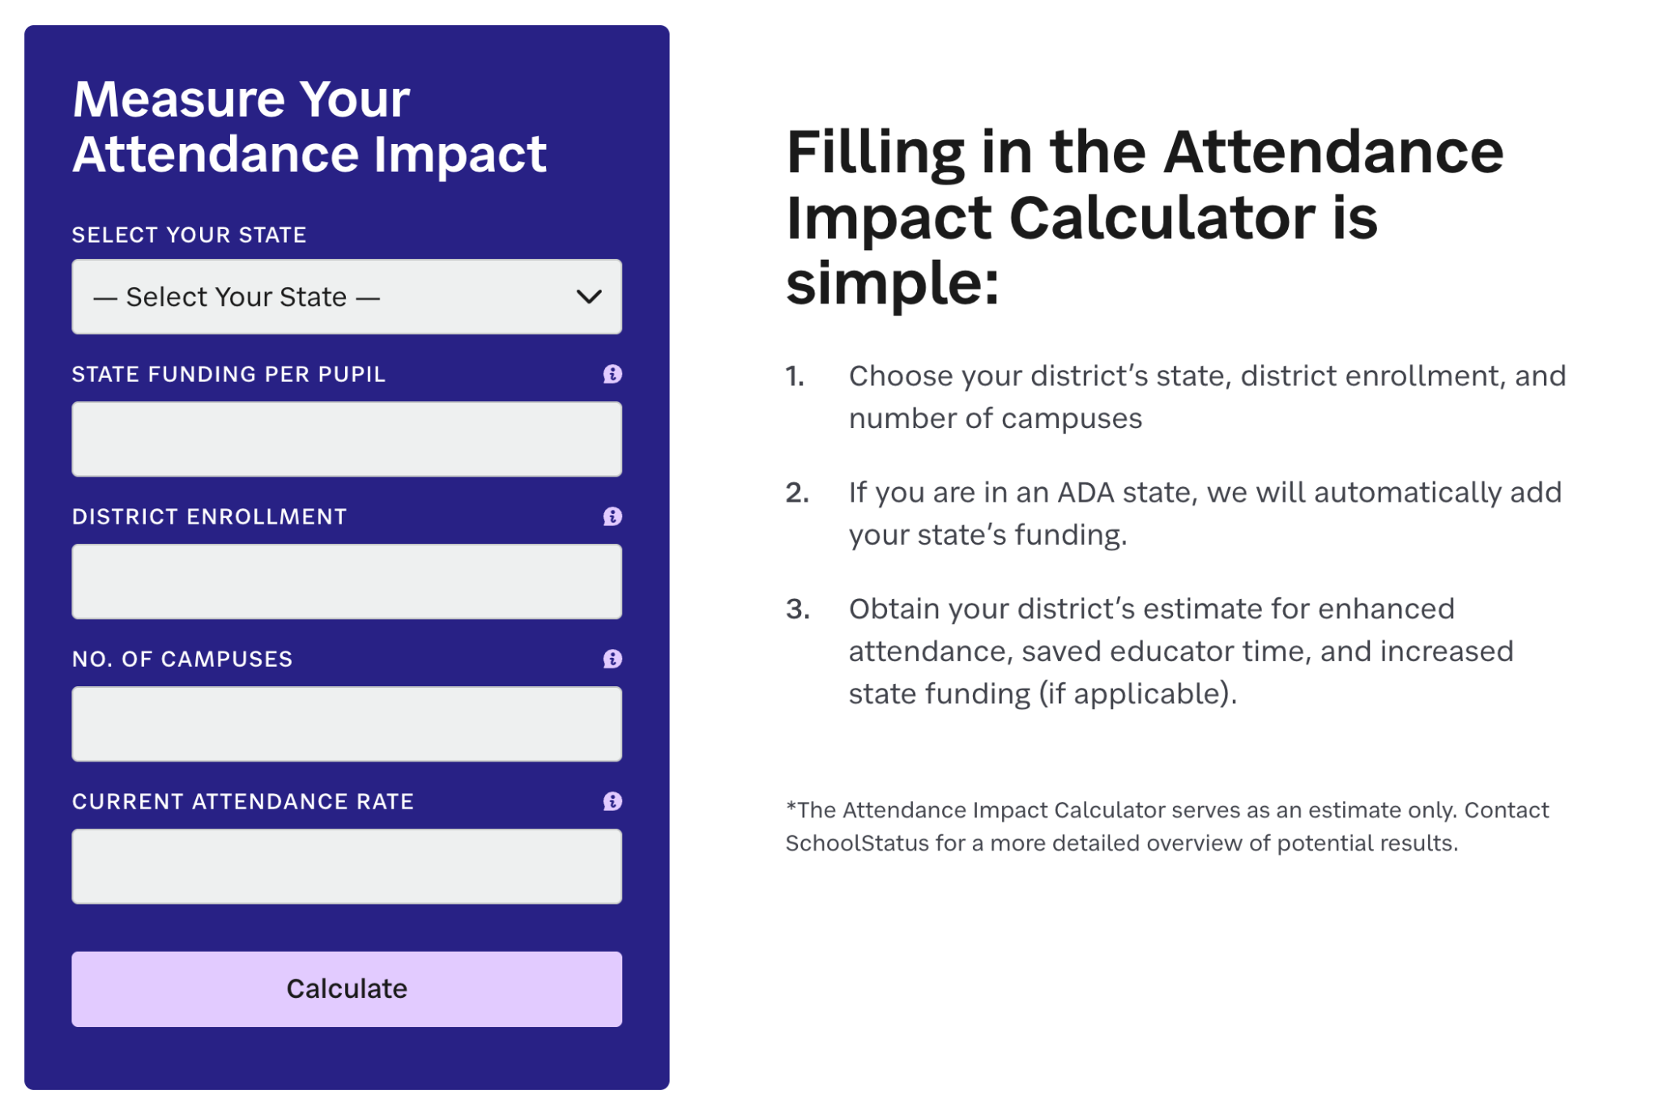
ADA Funding Deck: What You’ll Need to Gather
Pro Tip: Use the Attendance Impact Calculator
Your District's Numbers:
Current enrollment
Current chronic absenteeism rate
Current ADA rate
Your state's per-pupil funding formula
Number of chronically absent students
Calculate daily/annual revenue loss
Your Current Costs:
Staff hours spent on attendance weekly
Cost of those hours
Truancy proceeding costs (if tracked)
Other Information Available from SchoolStatus:
Custom pricing quote for your district
State-specific funding formula if not CA or TX
Contact: shannon.crawford@schoolstatus.com

Slide 3
Recovering
$[insert amount]
in Lost ADA Funding
A Strategic Investment in Attendance Management
District Name | Date | Name & Title

Slide 4
The Revenue Problem
Chronic Absenteeism:
5 Year Trend
We’re Losing Money Daily
Current chronic absenteeism: [INSERT]%
Students chronically absent: [INSERT NUMBER]
Annual revenue loss: $[INSERT]
[PLACEHOLDER]%
23.5%
15%
2019
Pre-Pandemic Average
2024-25
National Average
2024-25
District Average
Notes:
Presenter Notes:
This is recoverable revenue, not lost forever
Each 1% = $75K-$150K for 5,000 student district

Slide 5
How ADA Funding Works
Perfect Attendance
2 Days Absent/Month
[$12,000]
[$10,680]
Full ADA funding captured
100% attendance = 100% funding
Lost: $1,320 per student
89% attendance = 89% funding
Multiplied by 1,000 students = $1,320,000 in lost annual revenue
Notes:
Presenter Notes:
Unlike enrollment growth (takes years), attendance improvements show results in weeks
This is the fastest way to boost revenue

Slide 6
Where do we spend our time and resources?
Attendance is the #1 predictor of dropout and graduation rates
Course failures were attributed to:
5%
Test Scores
7%
Demographics/ Economics
67%
Attendance
Notes:
Presenter Notes: As much as we look at test scores, socio-economics, what we know is the number one predictor of student success is attendance. This data comes out of a study from the University of Chicago, and clearly illustrates the profound impact of attendance on student success, with attendance accounting for a staggering 67% of course failure. This underscores the urgency of prioritizing attendance support initiatives to address this key driver of academic performance. By directing resources towards proactive attendance strategies we CAN effectively tackle this pervasive issue.

Slide 7
Manual Interventions Are Expensive & Ineffective
Why Current Methods Aren’t Working:
Staff hours on attendance weekly: [INSERT]
Annual cost of that time: $[INSERT]
Days until intervention: [INSERT]
Success rate: [INSERT]%
Hidden Costs: Truancy Proceedings + Court Filings + Family Conferences = Tens of Thousands Annually
Notes:
Presenter Notes:
We're essentially paying money to lose money
Manual tracking means delayed intervention
Staff burnout from repetitive tasks
Research shows chronic absenteeism accounts for 16-27% of math score declines, 36-45% of reading declines
By intervention time, patterns are set

Slide 8

Automated Systems Deliver Immediate ROI
Real District Results:
Grand Prairie ISD (Texas):
26,600 students
32% reduction in chronic absenteeism
Prince William County (Virginia):
89,000 students
94% positive family response
Average Across 430+ SchoolStatus District Partners:
Up to 45% reduction in chronic absenteeism
How They Did It:
✔️ Real-time sync with SIS
✔️ Flag at-risk students early (2 absences, not 10)
✔️ Same-day family notification
✔️ Messages in home language
✔️ Track ROI automatically
Key Benefit: Frees staff time equivalent to
hiring additional one part-time employee
Notes:
Presenter Notes:
Manual tracking is expensive and too slow - by the time we intervene, patterns are set
Automated systems catch problems early (after 2 absences, not 10)
Messages go out same-day in families' home language
Strong family engagement reduced chronic absenteeism by 39% during pandemic
Success Examples to Reference:
Grand Prairie: 32% reduction, saved staff time = part-time employee
Prince William (89,000 students): 94% positive family response, millions recovered
Bottom Line: Cost of system = fraction of what we lose to absenteeism

Slide 9
The Investment and Return
 | Year 1 | Year 2 | Year 3
Investment | $[X] | $[X] | $[X]
Revenue Recovered | $[X] | $[X] | $[X]
Net ROI | $[X] | $[X] | $[X]
ROI% | $[X] | $[X] | $[X]
District Size Examples:
3,000 students: ~$160K recovered/year
10,000 students: ~$530K recovered/year
Notes:
Contact SchoolStatus for custom pricing
Presenter Notes:
Most districts see positive returns within first semester
This is recurring revenue recovery, not one-time
Strong family engagement impacts attendance as much as difference between in-person and remote learning
Frame as "protecting revenue" not "spending money"

Slide 10
Recommended Action
Timeline:
Month 1: Setup & integration
Month 2: Pilot & training
Month 3: Full deployment
Month 4: First revenue recovery visible
Success Metrics:
5% reduction in chronic absenteeism
Positive ROI within 6 months
Monthly progress reports
Why Act Now?
Every day = $[INSERT] in lost funding
Federal funding uncertainty
Neighboring districts already recovering revenue
Proposed Resolution:
Authorize administration to pursue attendance management solution with demonstrated ROI, not to exceed first-year revenue recovery projections
Notes:
Presenter Notes:
Emphasize this is about equity: chronic absenteeism disproportionately affects low-income students
With federal funding fluctuation, protecting ADA revenue is critical
Position as "revenue protection strategy" not "technology purchase"

Slide 11
Thank you

